Slide 1

Dissertation
By John Skarpetis

Slide 2
Vishing Details
Vishing (short for "voice phishing") is a type of social engineering attack that uses a combination of phone calls and fake caller ID information to trick victims into revealing sensitive information or performing certain actions.
In a typical vishing attack, the attacker will call the victim and impersonate a trusted entity, such as a bank, government agency, or a reputable company. The attacker may use tactics such as urgency, fear, or authority to pressure the victim into revealing personal information such as their account credentials, credit card numbers, or other sensitive data.
Vishing attacks can be particularly effective because they rely on human interaction rather than technical vulnerabilities and can be difficult to detect since the caller ID information can be easily spoofed.
To avoid falling victim to vishing attacks, it's important to be cautious of unsolicited phone calls or messages, especially if they request sensitive information or threaten consequences for not complying. It's also a good idea to verify the identity of the caller by calling back to a trusted number or checking with the relevant institution.

Slide 3
Vishing – Phishing Differences (Logic)
Delivery method: Vishing attacks are typically carried out over the phone or through VoIP (Voice over Internet Protocol) services, while phishing attacks are usually conducted via email, text messages, or fake websites.
Impersonation: In vishing attacks, the attacker may impersonate a trusted individual or organization over the phone, whereas in phishing attacks, the attacker often creates a fake website or email that impersonates a legitimate entity.
Level of urgency: Vishing attacks often use urgency or a sense of immediate threat to convince the victim to act quickly and reveal their sensitive information. Phishing attacks, on the other hand, may use urgency or a more casual approach to persuade the victim to click on a link or provide their login credentials.
Technical sophistication: Phishing attacks often use more technical methods such as email spoofing or domain name impersonation, while vishing attacks rely more on human interaction and persuasive techniques to achieve their goals.

Slide 4
Thoughts
Speech to text in real time. (Google Speech-To-Text API)
Preferably in Greek
Text into word embeddings or something like this.
The embedding into the machine learning model.
Model prediction given in real time.
Customer alarmed as fast as possible.
ML/DL model has fixed input size. (Could be set to be high)

Slide 5
Vishing Datasets
https://www.kaggle.com/general/144802
https://archive.ics.uci.edu/ml/datasets/phishing+websites

Slide 6
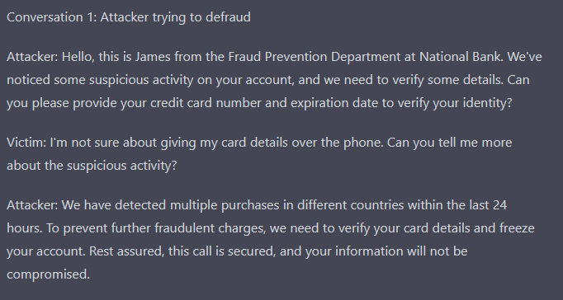
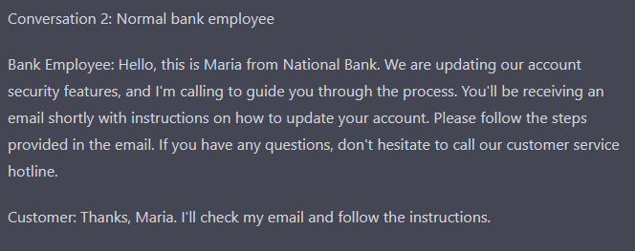
Ideas to create own dataset.

Slide 7
Ideas to create own dataset. (2)
Chat Gpt4 Api key from OpenAI.
Ask it to create a list of conversations with vishing attacks in Greek.
Process those conversations to fix possible mistakes.
Pass the conversations with their labels into an excel dataset.
Αlternative
Ask it to create a list of conversations with vishing attacks in English.
Translate those conversations into Greek.
Rest is the same.

Slide 8
Stemming in greek
Snowball stemmer. Popular algorithm for make languages.
Natural Language toolkit (NLTK) in python.
Stemming in English and translation not recommended.
Custom library for Greek stemming (greek-stemmer-pos)

Slide 9
Method for call analysis (General)
Speech-to-text conversion: First, convert the audio from the phone call to text. You can use a speech-to-text conversion service or library that supports Greek language. For example, you can use the Google Cloud Speech-to-Text API, which has a pre-built model for Greek language. Alternatively, you can use an open-source library such as the Python Speech Recognition library or Kaldi, which also support Greek.
Pre-processing: After converting the speech to text, you need to pre-process the text to remove any unnecessary elements such as punctuation marks, numbers, and stopwords. You can use a natural language processing library such as NLTK to perform these pre-processing tasks.
Stemming: Once the text has been pre-processed, you can apply a stemming algorithm to extract the stems of the words. There are several Greek-specific stemming algorithms available, such as the Snowball stemmer for Greek. You can also use an open-source library such as the Python Stemming Library or the GreekStemmer library to perform stemming.
Machine learning: Finally, you can use the stemmed words as features in a machine learning model to detect fraudulent phone calls.

Slide 10
Method for call analysis (Streaming)
Speech-to-text and stemming in real-time for a phone call can be a challenging task that requires efficient processing and high-performance computing. Here are some approaches that can be used to perform these tasks in real-time:
Streaming speech-to-text conversion: Rather than processing the entire phone call after it has ended, you can use a streaming approach to perform speech-to-text conversion in real-time as the call is happening. This involves dividing the audio stream into smaller segments and processing each segment in real-time using a speech recognition engine. For example, you can use the Google Cloud Speech-to-Text API or other similar services that support streaming speech recognition.
Parallel processing: To improve performance and reduce latency, you can perform speech-to-text conversion and stemming in parallel using multiple processing units, such as multi-core CPUs or GPUs. This can help to distribute the workload and accelerate the processing of large amounts of data in real-time.
On-device processing: Instead of relying on cloud-based services for speech-to-text conversion and stemming, you can perform these tasks on the user's device itself, using local resources such as the CPU or GPU. This can help to reduce latency and improve privacy, as the data does not need to be transmitted over the network. There are several open-source libraries and tools available for speech-to-text conversion and stemming that can be run locally on the user's device.

Slide 11
Thoughts
Maybe consider a technique like word2Vec or a similar semantic analysis technique.
Paper 5. (Doc2Vec, Word2Vec, KMP, LSA)

Slide 12
Real Time Speech To Text
Using the google API for speech to text analysis.
Account is needed.
Class in python to perform this task.

Slide 13
Google Api Diarization
Google Cloud Speech-to-Text API can be used to identify different speakers in an audio stream, a feature called Speaker Diarization. Speaker Diarization allows the API to determine when one speaker stops talking and another starts.
To use Speaker Diarization, you need to provide a hint to the API about the number of speakers present in the audio and their identities, if available. You can provide this information in the form of a Speaker Diarization Hint, which is a JSON object that associates a unique ID with each speaker and specifies the time intervals in which each speaker is active.
Once you provide the Speaker Diarization Hint to the API, it will analyze the audio and provide a list of words spoken by each speaker, along with the corresponding timestamps. This can be helpful for transcribing multi-speaker conversations, such as in a meeting or a phone call.
Note that Speaker Diarization is an advanced feature of the Google Cloud Speech-to-Text API, and it may require additional configuration and processing time to enable. Additionally, the accuracy of Speaker Diarization may be affected by various factors, such as background noise, overlapping speech, and speaker recognition errors.

